Slide 1
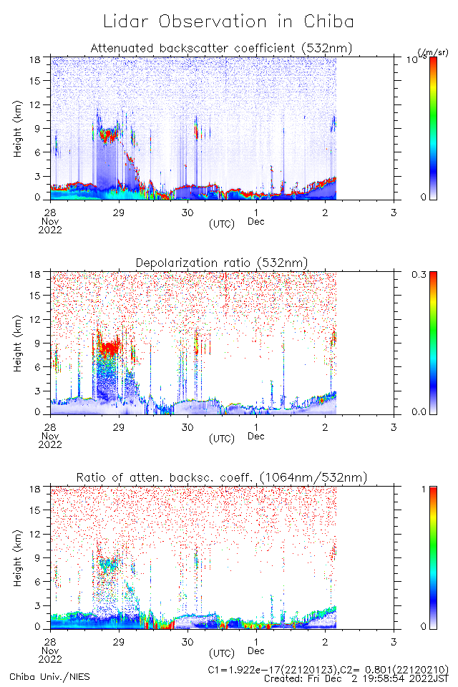
Lidar data
Cloud base was gradually lifted up.
ice clouds?
※Note that time is in UTC.

